Slide 1
Sports day
By Danny Mc Mullan

Slide 2
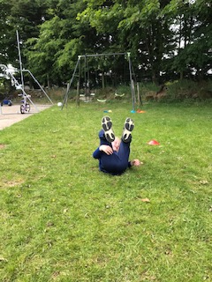
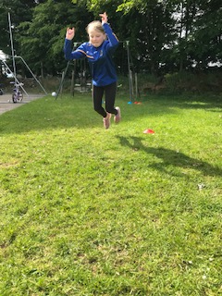
INSTRUCTIONS FOR EACH EVENT.
On Thursday 11th of June we did home sports day. We did the welly toss, the super strong challenge, the egg and spoon race, the marathon and the long jump. We needed cones and a whistle and a phone.
It was a lovely day.

Slide 3
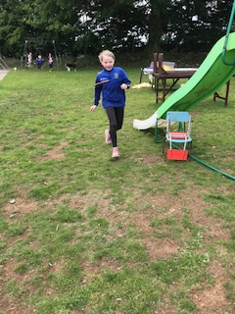
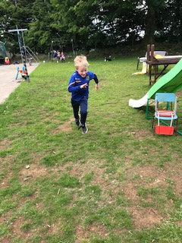
Sprint
We measured out twenty metres and marked it with two cones. We had to run as fast as we could and mammy timed it on her phone. It was very hard. I ran very fast at the start but I got slower at the end. Rose had to run for longer than me.

Slide 4
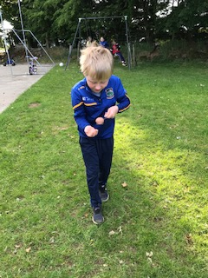
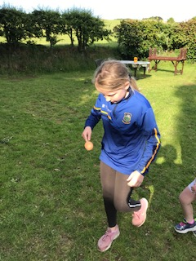
EGG AND SPOON RACE
Maria went first.
It might have dropped but she was the fastest.
Then I went. I went slowly so I would not drop the egg. Then Rose went.
She also went slowly.
I dropped the egg two times and the egg cracked. Our dog Jess was licking her lips.

Slide 5
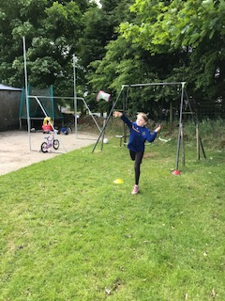
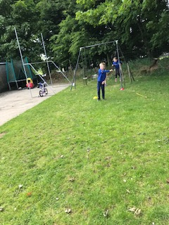
Welly toss.
Maria went first. She threw it really far.
Then it was my turn. I also threw it far.
Then Rose went. She threw it the farthest.
We had to measure it with a measuring tape.

Slide 6
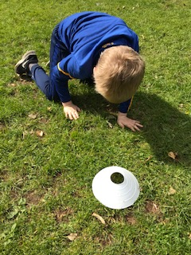
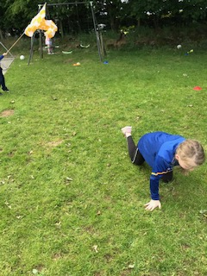
SUPER STRONG Challenge.
Maria went first again she was good at it.
Then I went next. I did well.
Then Rose went.
She was really really good.
She went round 2 times.
Me and Maria went round 1 time.

Slide 7
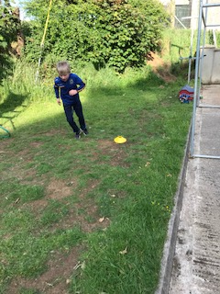
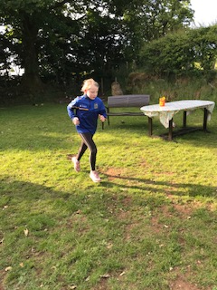
MARATHON
This time me, Rose and Maria went together. I started fast but then I slowed down.
I got 25 laps around the garden.
Me and Maria did it for 5 min.
Rose did it for 7 min.

Slide 8
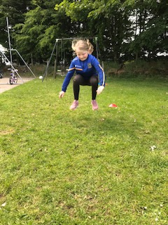
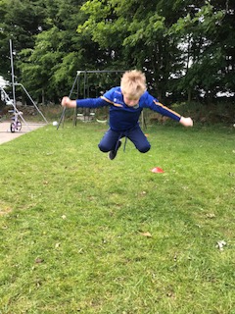
LONG JUMP
This was the last event. I went first.
I got the longest jump.
Then Rose went, I was farther then her.
But it’s not about winning it is about taking part.

